Slide 2

Project 3: Law-based and document-based chatbot
Trieu Kinh Quoc | 20225524

Slide 3
Table of contents
1. Topic
2. Updated Progress
3. Upcoming Work

Slide 4
1. Topic
Purpose:
- Propose the use of vector database (RAG) and LLM system for helping answer user queries.
- Two specific tasks:
Answer user’s query based on references laws.
Answer user’s query based on a document.
- Build the interactive interface that user can communicate with the chatbot.
- Final output: Simulate multi-agent AI for improving the accuracy of answers.

Slide 5
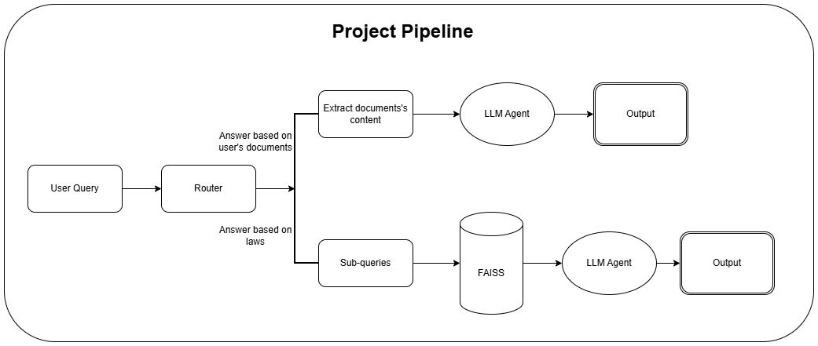
1. Topic

Slide 6
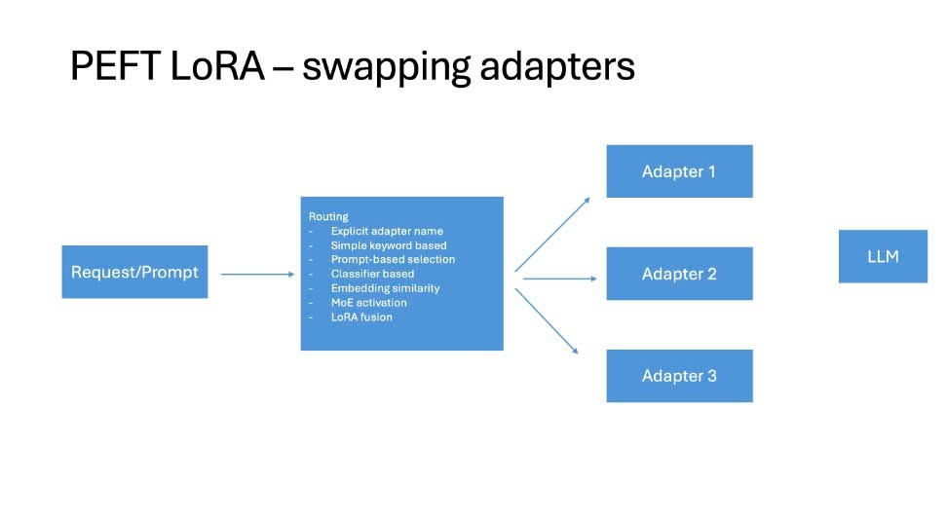
2. Updated Progress
- Tried 4 different techniques for improving the router:
Simple keyword based
Prompt-based selection
Classifier based
Embedding similarity

Slide 7
2. Updated Progress
2.1. Router by simple keyword matching based
- Idea: Depends on specific keywords in query, destinate to suitable route.
- Implementation:
Two list of keywords:
documents keywords: ["văn bản", "tài liệu", "file", "đoạn văn", "bài viết"]
laws keywords: ["luật", "điều", "mức phạt", "theo pháp luật", "quốc hội", "hành vi"]
If query contains any keywords belong to specific route, it will be destined to this route. If not, if at least a file is uploaded by the user, it will route to “documents”, otherwise “extract_laws”

Slide 8
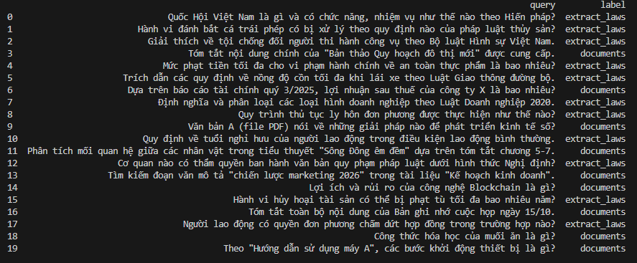
2. Updated Progress
2.2. Router by classifier based:
- Idea: Train a small neural network model that classifies into 2 class: extract_laws or documents based on input queries. (binary classification)
- Dataset: Taken from two datasets:
9000 queries from: Vietnamese Legal Dataset (train dataset) (labelled as extract_laws)
10000 queries from: UIT ViQUAD2.0: dataset hỏi đáp tiếng Việt (train dataset) (labelled as documents)
- The dataset contains total 19000 samples
First 20 samples of dataset

Slide 9
2. Updated Progress
2.2. Router by classifier based:
- Implementation:
Embedding model: “intfloat/multilingual-e5-large” - 1024 dimension (same as vector database embedding)
Model architecture:
Fully connected layer 1 (fc1): 512 nodes
Fully connected layer 2 (fc2): 2 nodes
Dropout rate: 0.3
=> Model flow: embedding => fc1 => relu activation => dropout => fc2
Loss function: CrossEntrophyLoss
Optimizer: AdamW
=> With the dataset, the classifier is trained through 20 epochs so that it is capable of classifying user’s query.

Slide 10
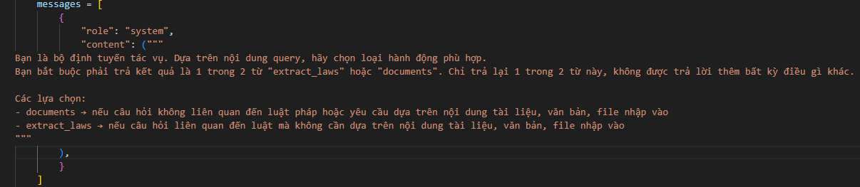
2. Updated Progress
2.3. Router by prompt based selection:
- Idea: Used LLM to select the route.
- Implementation: Feed prompt into LLM so that it can generate corresponding routes:
Router by prompt based selection implementation

Slide 11
2. Updated Progress
2.4. Router by embedding similarity:
- Idea: For each query, the vector is retrieved in both documents and laws index. The similarity score will decide the vector.
- Implementation:
For each uploaded document, the content is chunked to 300 tokens, with stride of 50 tokens.
Build an IndexFlatL2 for chunked documents.
Vector is retrieved in both documents and laws index. The index having more similarity will be the router decision.

Slide 12
2. Updated Progress
Evaluate:
- 1000 queries from: legal questions (test dataset)
- 1000 queries from: UIT ViQUAD2.0: dataset hỏi đáp tiếng Việt (test dataset)
- Metrics used:
Precision (TP/TP + FP) (per class)
Recall (TP/ TP + FN) (per class)
F1 (per class)
Accuracy (true classification/ total classification)

Slide 13
2. Updated Progress
Phương pháp | Accuracy | Documents |  |  | Extract laws
 |  | precision | recall | f1 | precision | recall | f1
Matching based router | 0.55 | 0.53 | 0.92 | 0.67 | 0.7 | 0.18 | 0.28
Classifier based router | 0.97 | 0.96 | 0.99 | 0.97 | 0.99 | 0.96 | 0.97
Prompt based router | 0.54 | 0.52 | 0.95 | 0.67 | 0.73 | 0.13 | 0.22
Embedding similarity router | 0.98 | 1.00 | 0.97 | 0.98 | 0.97 | 1.00 | 0.98

Slide 14

3. Upcoming Work
- Transform to a multi-agent system:
Router Agent: define the types of queries.
Law Agent: answer users queries based on references laws.
Document Agent: answer users queries based on documents.
Verifier Agent: verifies outputs of others agent to give the final answer.
Reasoning Agent: reasoning the output of each agent.
=> For each agent, I will try to fine-tune the LLM. If not, find the suitable Adapters in Hugging Face.

Slide 15
THANK YOU !

